Slide 1



UNIFIED MENTOR
MACHINE LEARNING INTERN
NAME :
VIMALRAJ D
UNID :
UMIP22414
E-MAIL :
vimalrajnov172005@gmail.com

Slide 2

TITLE : ANIMAL CLASSIFICATION
USING CNN
INTRODUCTION :
.
This project develops a CNN to classify images into 15 animal categories, such as Bear, Cat, and Zebra, using PyTorch. The dataset, comprising diverse animal images, is preprocessed with resizing, normalization, and tensor conversion for efficient training.
A custom CNN architecture is designed to extract and learn animal-specific features, ensuring robust performance. The aim is to create a reliable model for applications like wildlife monitoring and conservation.
.

Slide 3
DATA PREPARATION :
.
The dataset contains labeled images of 15 animal classes and is split into 80% training and 20% validation sets. Preprocessing includes resizing images to 128x128 pixels, normalizing pixel values, and converting data into tensors for PyTorch.
Augmentation techniques like rotations or flips enhance generalization by introducing diversity. Data batching and shuffling, handled by PyTorch’s DataLoader, ensure efficient training and exposure to varied examples.
These steps standardize the input, enabling the model to focus on key animal-specific features. This meticulous preparation ensures a clean, well-organized dataset optimized for training and validating the CNN.
.
.

Slide 4
MODEL TRAINING
.
A custom CNN with convolutional, pooling, and fully connected layers was trained using a batch size of 32 for 10 epochs. The Cross-Entropy Loss function and Adam optimizer facilitated efficient learning, with a scheduler dynamically adjusting the learning rate.
Metrics, including training and validation loss and accuracy, were tracked to monitor performance and adjust hyperparameters as needed. Validation ensured generalization to unseen data, while iterative improvements refined the model’s performance.
The architecture balanced complexity and regularization, resulting in a reliable model capable of distinguishing 15 animal classes effectively.
.
.

Slide 5
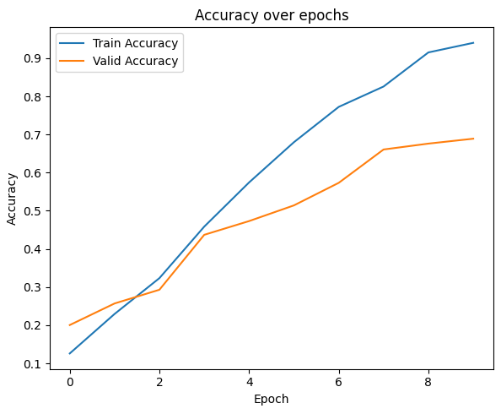
The CNN showed consistent training and validation accuracy, confirming effective learning.
Loss and accuracy plots highlight smooth convergence with minimal overfitting.
Correctly classified examples, like cow and zebra, demonstrate the model’s reliability.
Misclassified images suggest potential for improvement with additional data or tweaks.
RESULTS AND VISUALIZATION

Slide 6
CONCLUSION
The CNN effectively classified animals across 15 categories, demonstrating reliable accuracy and generalization. Future efforts will focus on expanding the dataset, improving with advanced architectures like ResNet, and deploying the model for real-time use. These steps can enhance its applications in wildlife conservation and education.

Slide 7
TITLE : LIVER CIRRHOSIS STAGE
DETECTION
INTRODUCTION :
.
Liver cirrhosis is a chronic condition characterized by scarring of the liver tissue, which can lead to significant health complications.
The objective of this project is to predict the stage of liver cirrhosis using a machine learning approach. The dataset used for this study, liver_cirrhosis.csv, contains various features like patient demographics, medical conditions, and test results.
By preprocessing the data and applying classification algorithms, this project aims to create an effective predictive model for cirrhosis staging.
.
.

Slide 8
DATA PREPROCESSING :
.
The dataset required extensive preprocessing to make it suitable for machine learning. Categorical columns such as Status, Drug, Sex, Ascites, Hepatomegaly, and others were transformed into numerical features using one-hot encoding.
The target variable, Stage, represents the progression of liver cirrhosis. This preprocessing step ensures that the data is clean and structured for accurate modeling and prediction.
.
FEATURE AND TARGET SELECTION :
.
After preprocessing, the features (X) were separated from the target variable (y), which corresponds to the cirrhosis stage. The dataset was split into training and testing sets, with 80% of the data used for training and 20% for testing.
This division ensures the model can learn patterns effectively from the training data while being evaluated on unseen data for unbiased performance metrics.
.

Slide 9
MODEL BUILDING
A Random Forest Classifier was chosen as the primary model for its reliability and ability to handle both numerical and categorical features.
This model uses an ensemble of decision trees to predict the cirrhosis stage. Metrics such as accuracy, classification reports, and confusion matrices were used to evaluate the model's performance.
This approach provides a robust framework for identifying the progression of liver cirrhosis based on patient data.
.
.
.

Slide 10
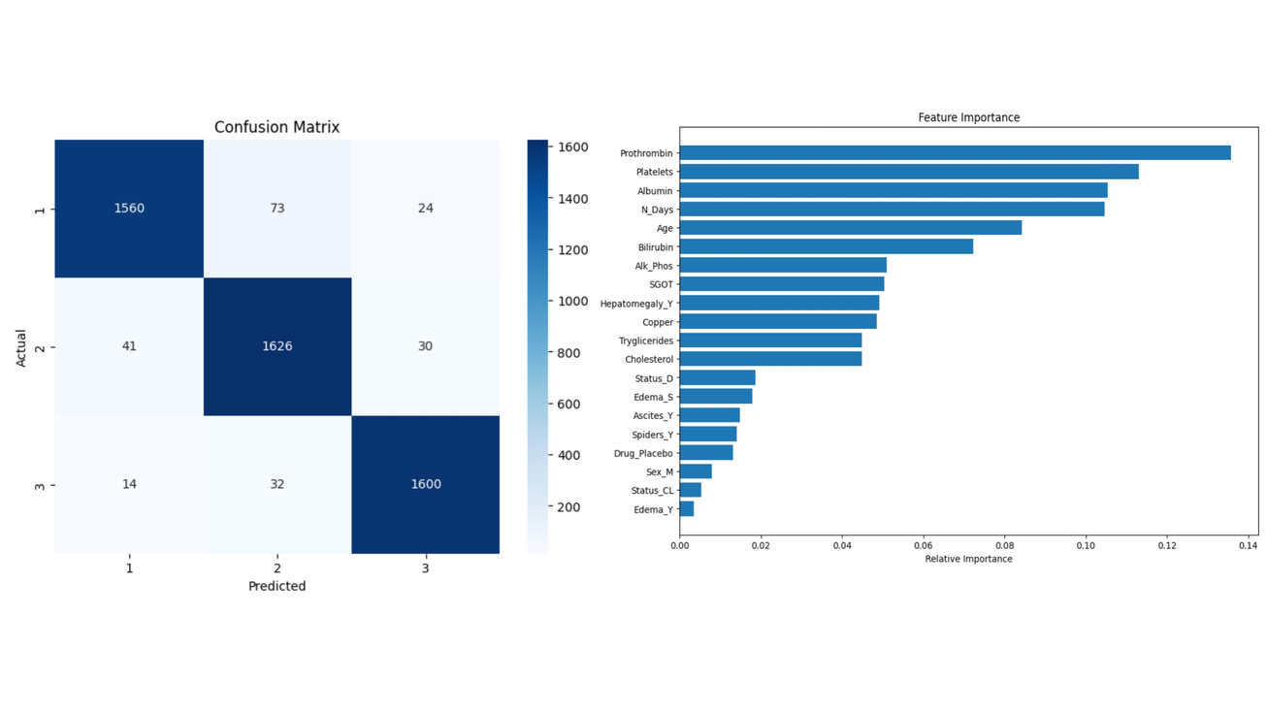
RESULTS AND VISUALIZATION :
The confusion matrix shows high accuracy, with most predictions aligning correctly with actual stages.
Key features driving predictions include Prothrombin, Platelets, and Albumin.
The model demonstrates robust performance with minimal misclassifications across stages.
Feature importance analysis provides valuable insights for prioritizing diagnostic tests.

Slide 11
CONCLUSION
The Liver Cirrhosis Prediction Project successfully utilized a Random Forest Classifier to predict cirrhosis stages with high accuracy. Key features like Prothrombin and Platelets were identified as important predictors, offering valuable insights for early diagnosis and management.

Slide 12
THANK YOU

